Slide 1
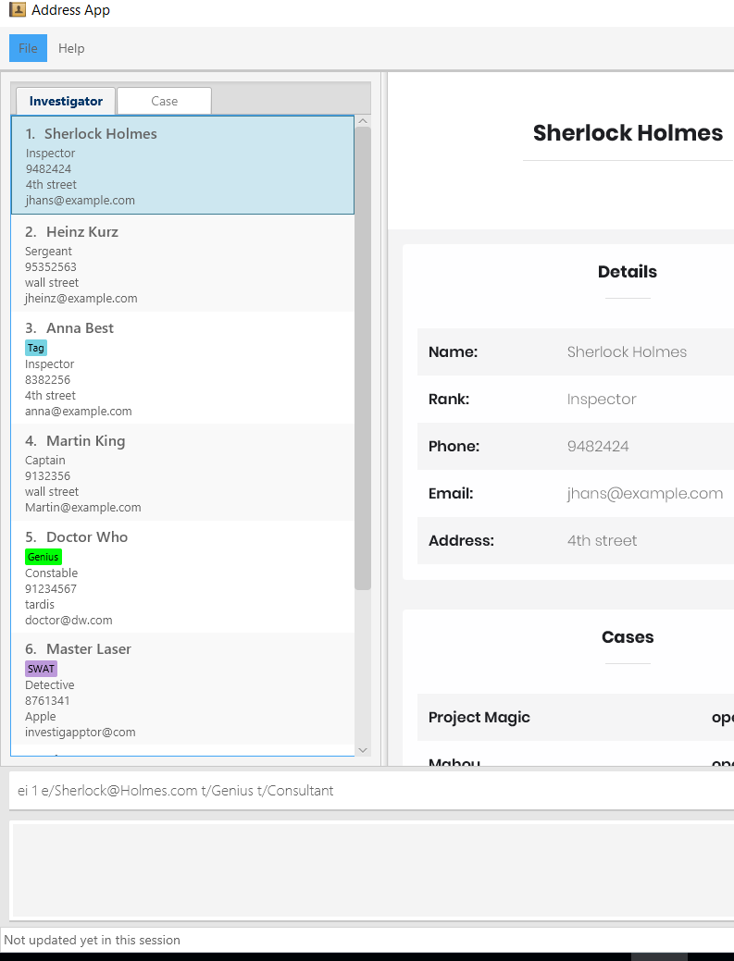
1. Use the index to indicate which Investigator you want to edit
2. Enter the details that you want to change

Slide 2
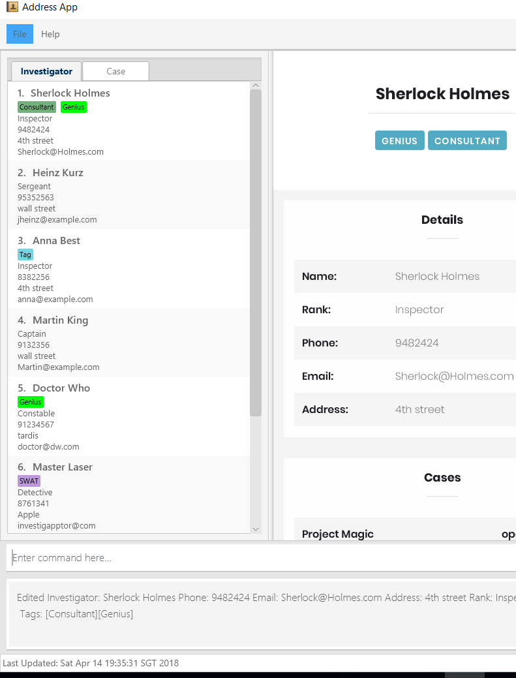
Changes will be seen in both the panel list and the detail panel
2. Changes made to the investigator will be indicated here as a success message

Slide 3
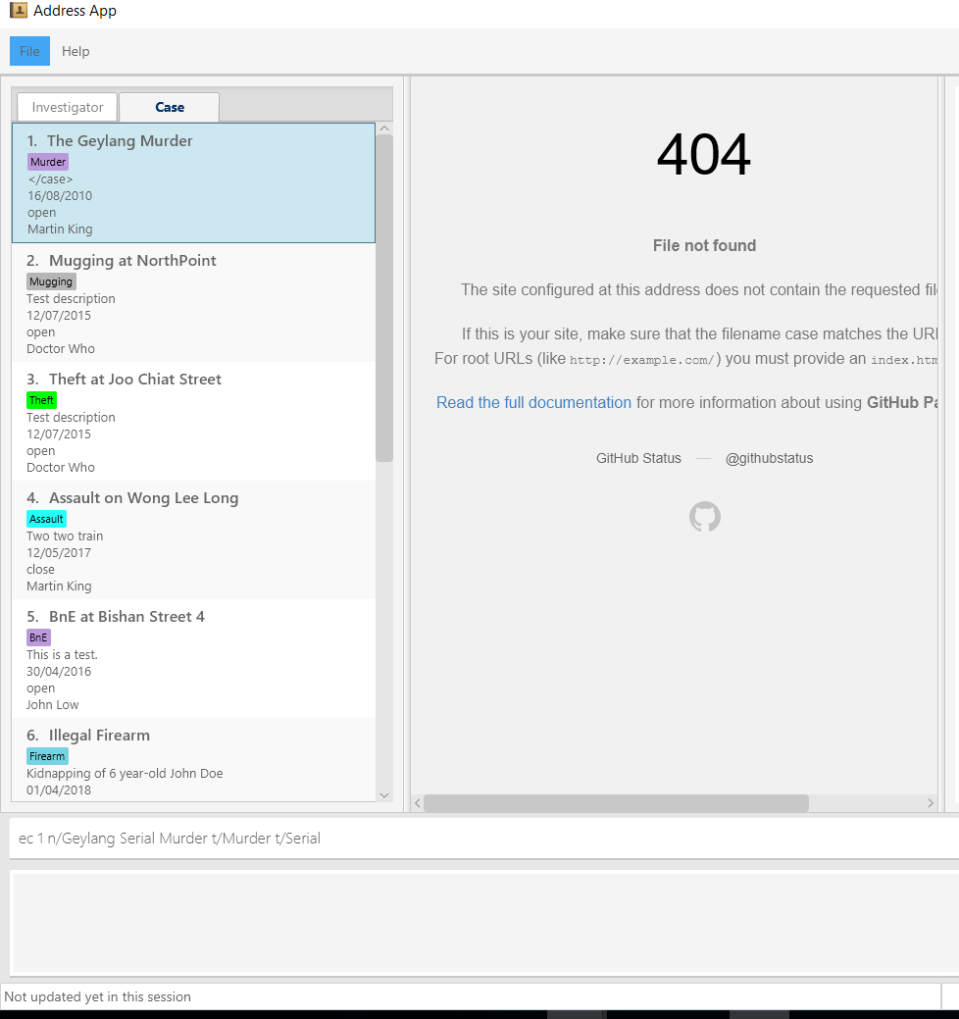
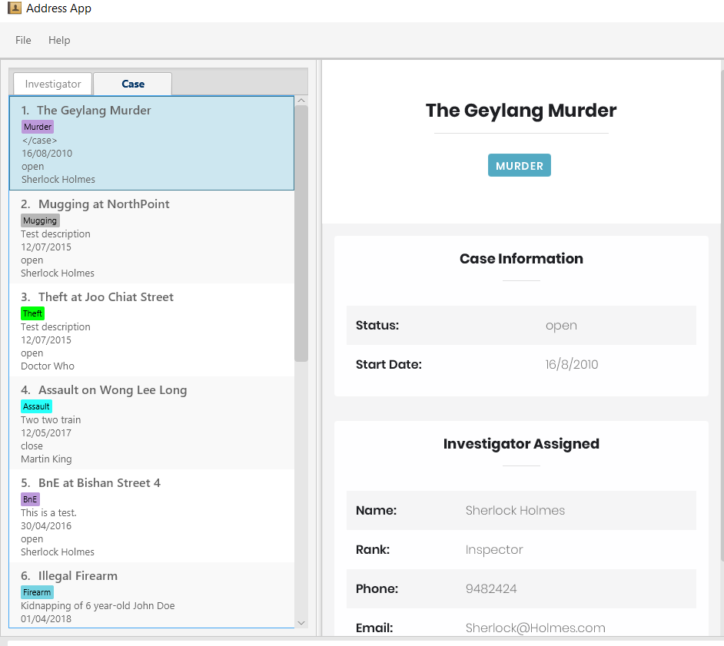
1. Use the index to indicate which case you want to edit
2. Enter the details that you want to change

Slide 4
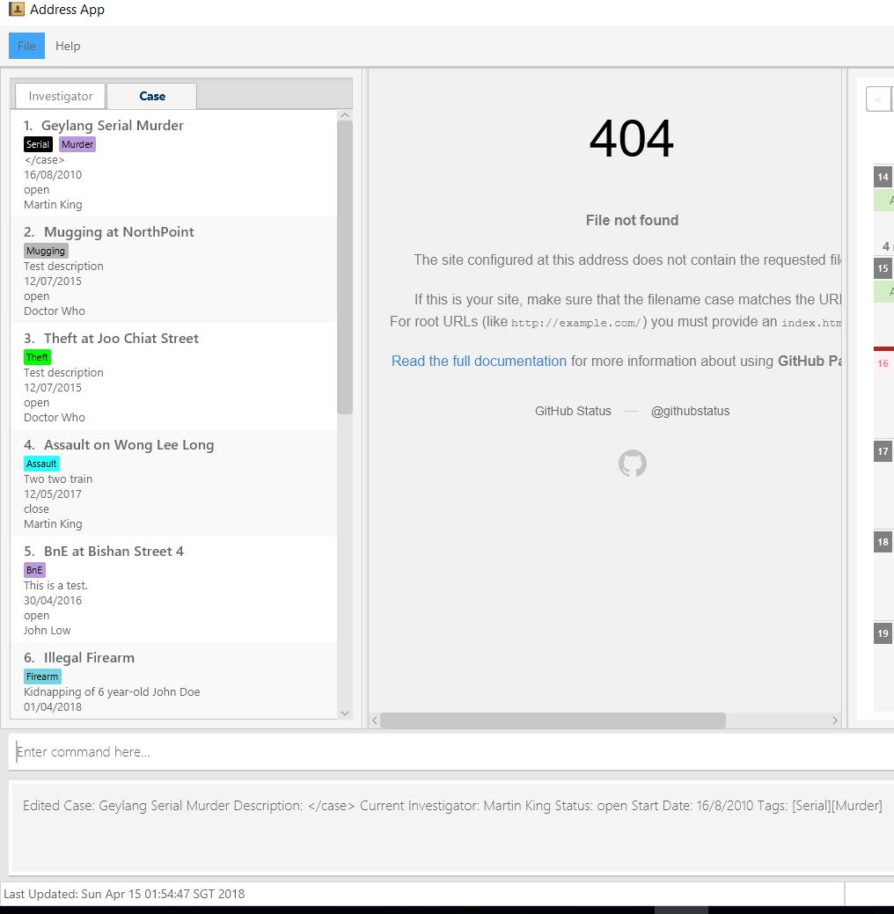
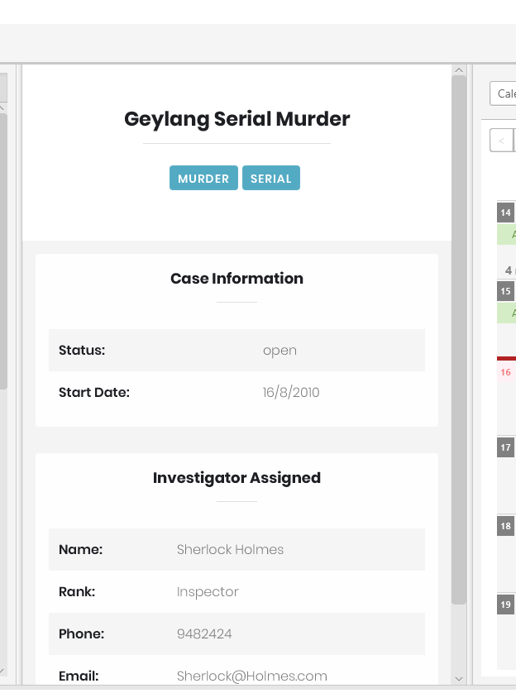
Changes will be seen in both the panel list and the detail panel
2. Changes made to the case will be indicated here as a success message

Slide 5
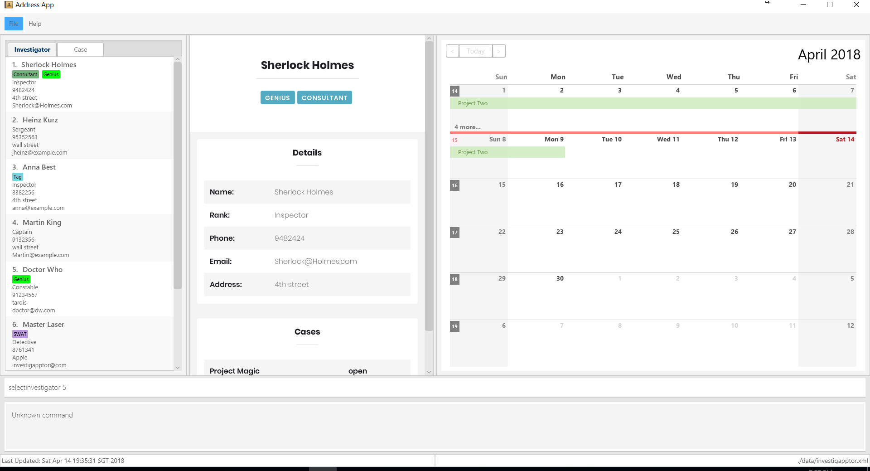

Slide 6
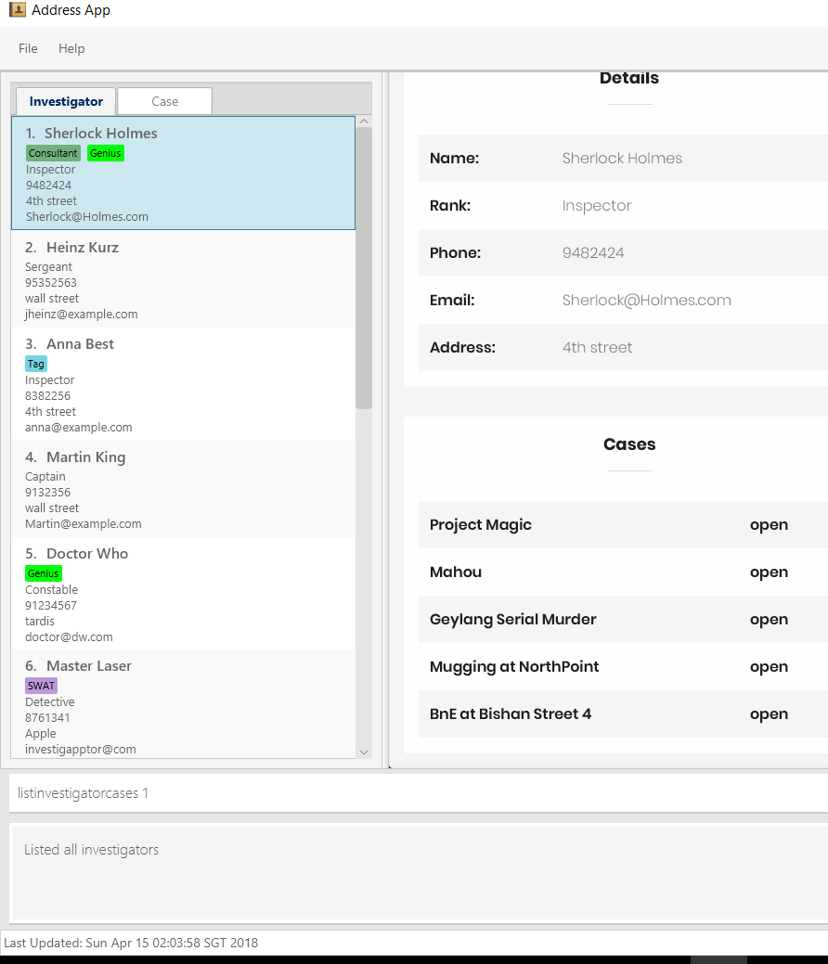
1. Use index to indicate which investigator’s cases you want to view

Slide 7
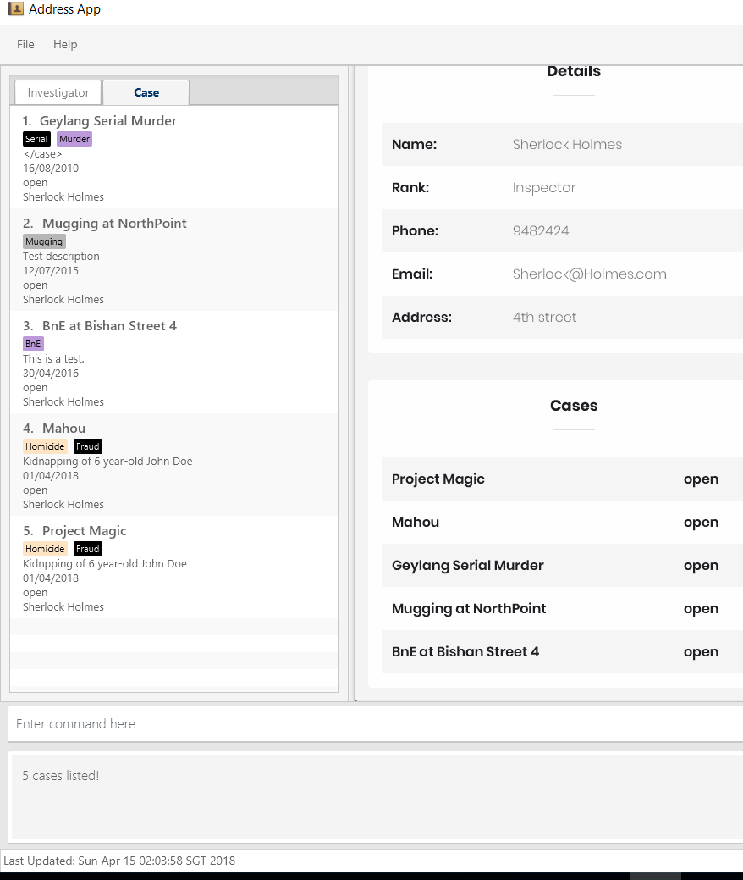
The cases under the investigator are now displayed on the list panel
Success message show how many cases belong to the selected investigator

Slide 8
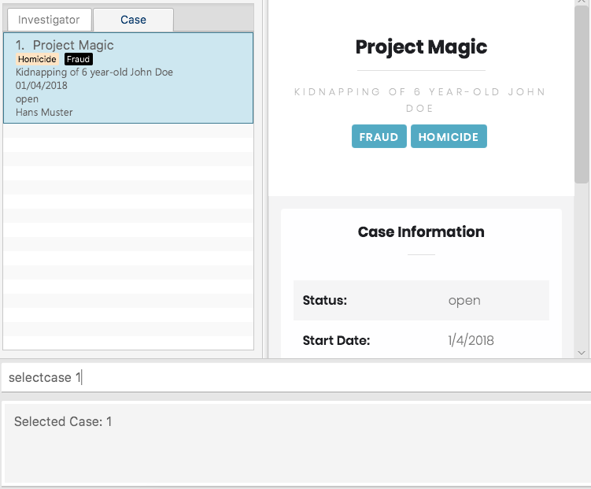
1. Use the index to indicate the case you wish to view
3. Panel shows details of selected case
2. On success, the status message shows the index of the case that has been selected

